Slide 2
Problem
Traditional alarms can be easily dismissed or snoozed and do not consider the user's sleep schedule, wake-up behavior, or personal goals.
Objective
Develop an intelligent alarm platform that:
Encourages consistent wake-up habits
Uses personalized wake-up interactions
Tracks sleep and wake-up behavior
Reduces oversleeping and excessive snoozing
Supports healthier routines

Slide 3
User
↓
Personalized Profile
↓
Sleep & Wake-up Goals
↓
Smart Alarm
↓
Cognitive Interaction
↓
Wake-up Verification
↓
Behavior Analysis
↓
Personalized Recommendations
Existing Problem
Traditional alarm systems:
Can be easily dismissed.
Allow repeated snoozing.
Do not consider individual sleep patterns.
Do not track wake-up consistency.
Do not provide personalized wake-up experiences.

Slide 4
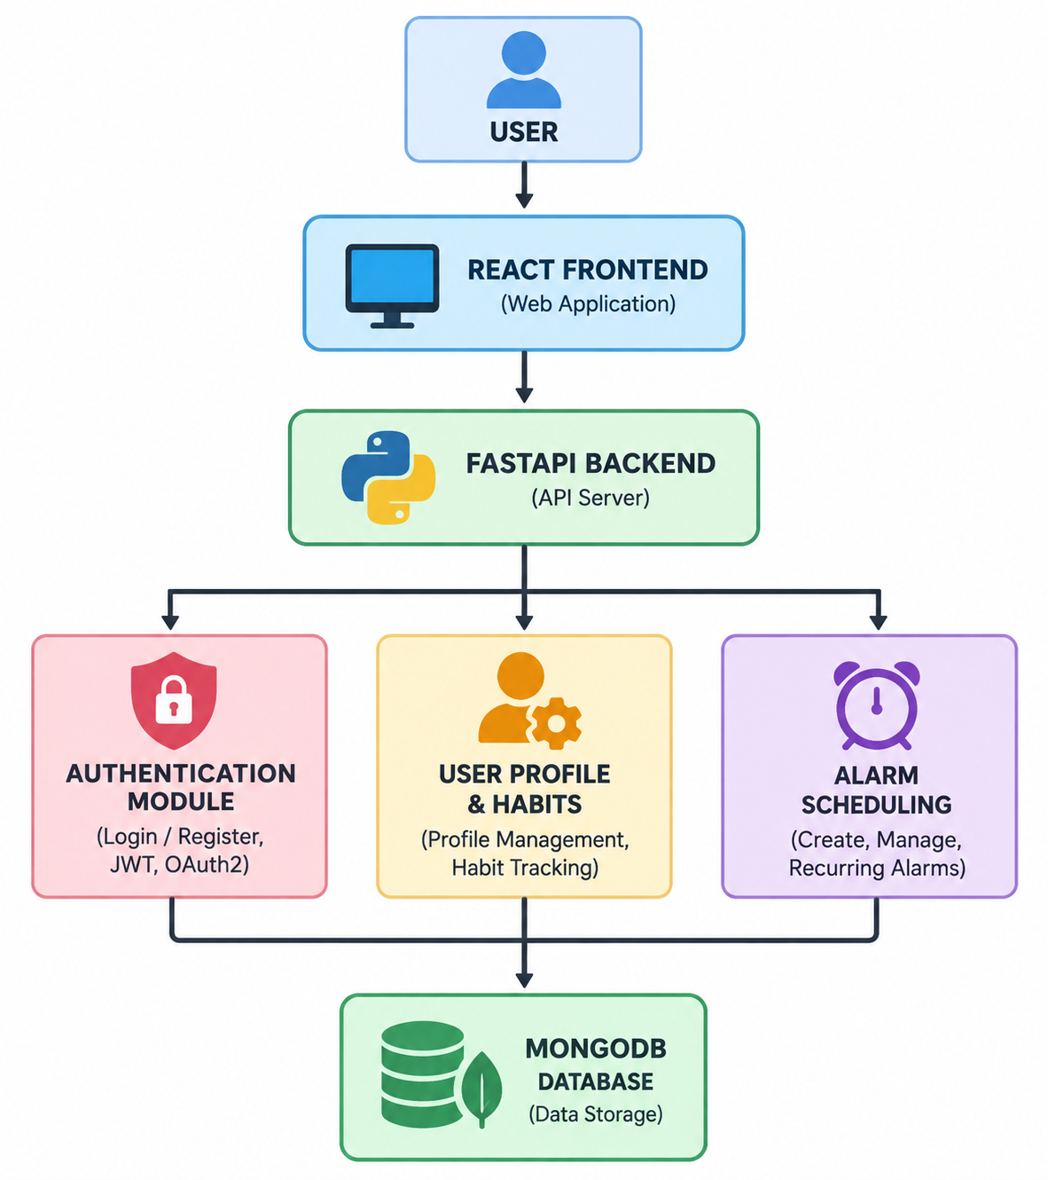
System Architecture

Slide 5
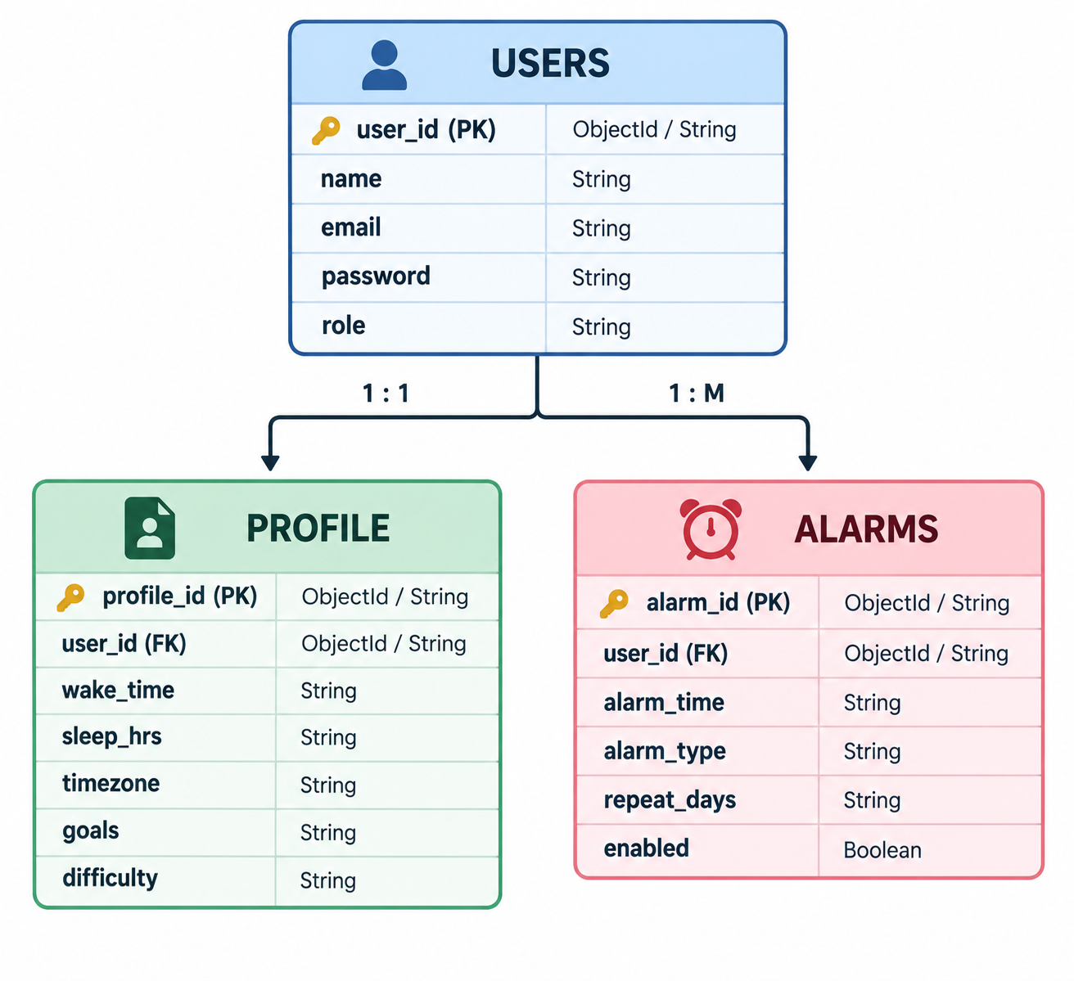
Core Database Schema
Profile Information
Preferred Wake-up Time
Sleep Duration
Time Zone
Productivity Goals
Difficulty Preference
Habit Preferences

Slide 6
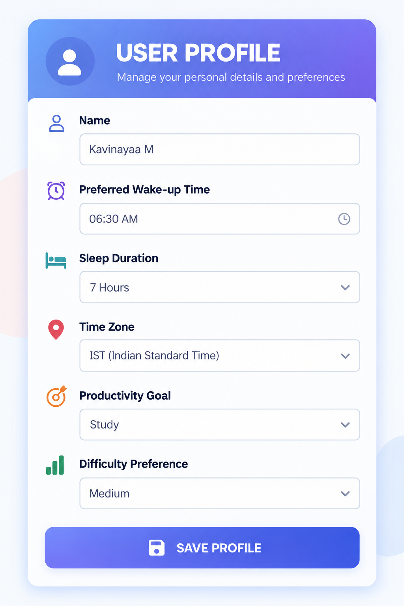
USER PROFILE & HABIT MANAGEMENT
Habit Management
Sleep Schedule
→ Bedtime + Wake-up time
Wake-up Goal
→ Target wake-up time
Productivity Goal
→ Daily productivity target
Habit Preferences
→ Personalized routine preferences

Slide 7
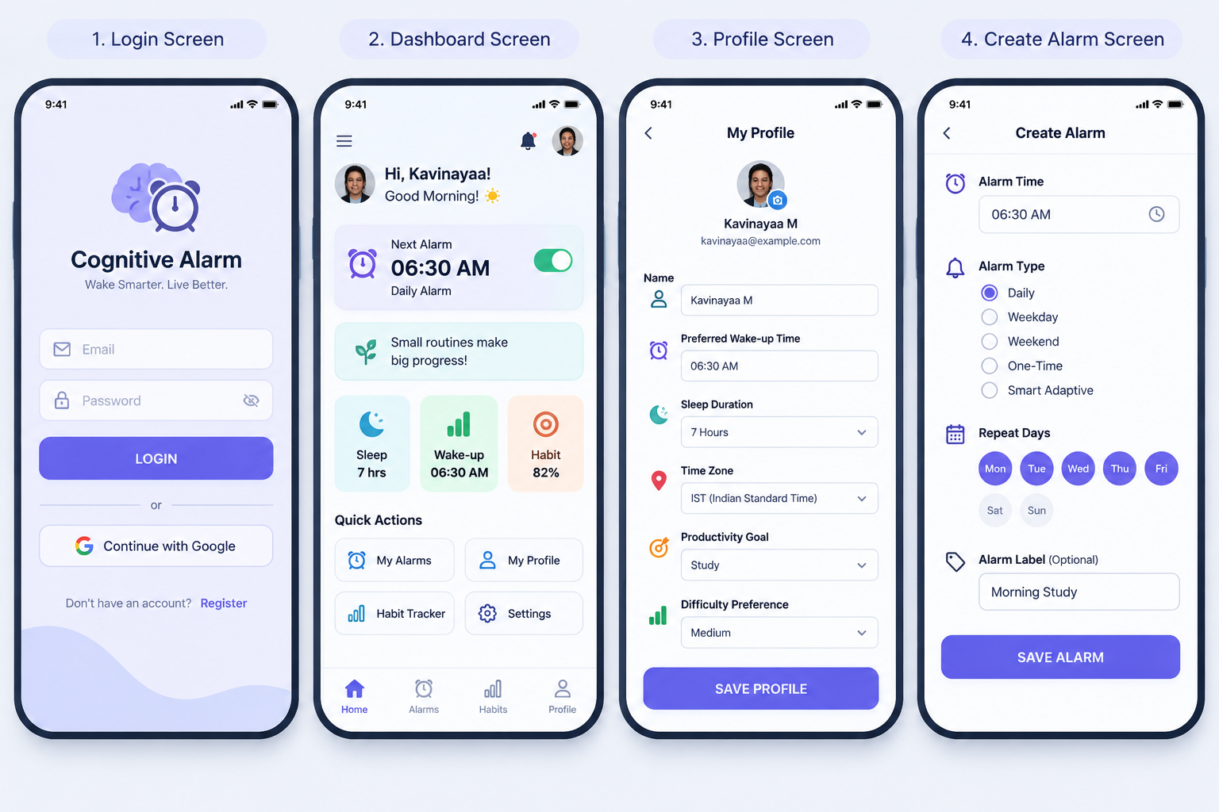
UI WIREFRAMES & ALARM WORKFLOW

Slide 8
Alarm Workflow
Create Alarm
↓
Select Time
↓
Select Alarm Type
↓
Set Repeat Schedule
↓
Save Alarm
↓
Alarm Added to Dashboard

Slide 9
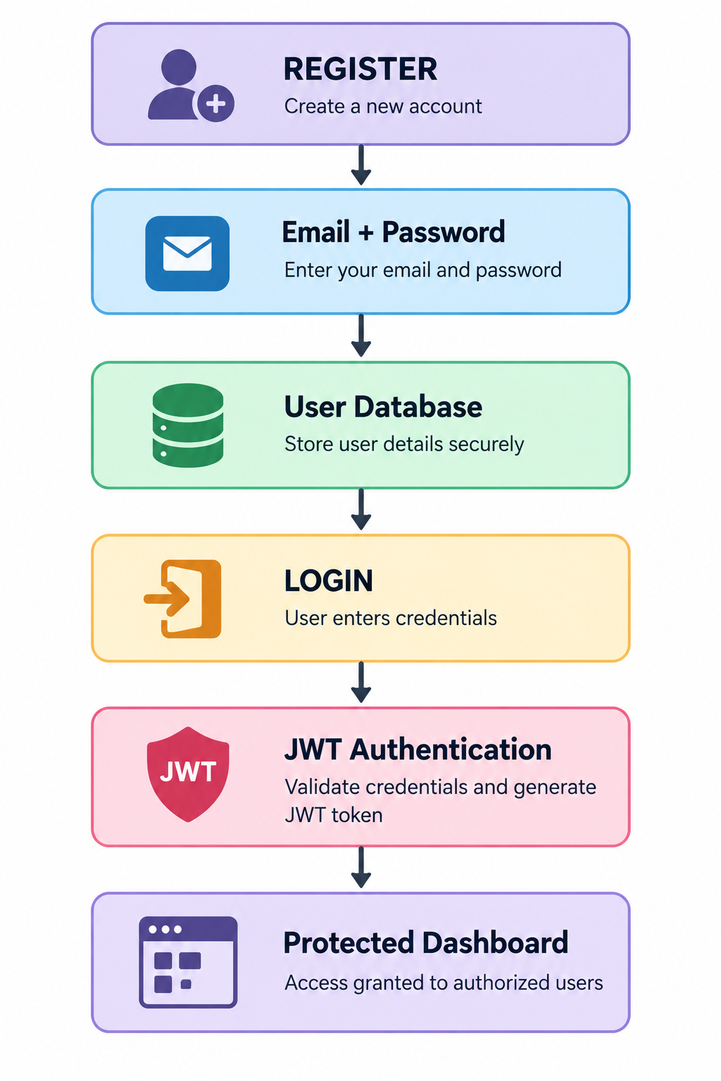
Authentication Flow

